Slide 1


Employer MyBenefits Portal Tutorial
Canceling An Employee
Single or Multiple Transactions

Slide 2
Before You Begin
2 of 12
Helpful Tip
Verify the employee's Last Date of Coverage before submitting the transaction. Incorrect dates may delay processing or require additional corrections.
Before canceling an employee, please review the following information:
Employee cancellations can be submitted at any time during the year.
Future termination dates are accepted.
Retroactive cancellations cannot be processed through the Employer Portal. (See your EASI Edu Rep)
Complete one transaction at a time when using the Single Employee option.
Have the employee's termination information available before starting.

Slide 3
Before You Begin
3 of 12
You must be logged into the NMPSIA MyBenefits Portal before
completing this tutorial.
If you are a new user, forgot your password, or experience login issues, please refer to the Employer Login Tutorial https://nmpsia.com/employer-trainings.html for complete step-by-step instructions.
Important Reminders
• MFA codes expire after 5 minutes.
• Use the email associated with your NMPSIA benefits.
• Check your Spam or Junk folder if you do not receive your code.
Need help logging in?
Please refer to the Employer Login Tutorial before continuing.
The Employer Login Tutorial includes:
✔ First-Time Login
✔ Password Assistance
✔ MFA Verification
✔ Common Login Errors
✔ Account Assistance
Helpful Tip
Bookmark the Employer Portal login page for quicker access in the future.
Go to NMPSIA.com
↓
Benefits Portal Login
↓
Select Employer
↓
Enter District ID
↓
Select Representative
↓
Enter Password
↓
Complete MFA Verification

Slide 4
What You'll Need
4 of 12
Helpful Tip
Verify you have all information before beginning.
Before beginning, have the following information available:
District ID
Your login credentials
Access to your authentication email
Employee Social Security Number (SSN)
Employee Last Day Worked
Employee Last Payroll Deductions
Effective Date

Slide 5
Transaction Overview
5 of 12
Helpful Tip
Every Employer Portal transaction follows the same basic process:
→ Enter → Review → Submit → Verify
Although each transaction may require different information, the overall process remains consistent throughout the Employer Portal.
This tutorial will show you how to:
Enter all required employee information.
Review the transaction for accuracy.
Submit the transaction for processing.
Verify that the transaction was successfully submitted.
Understand what happens after submission.

Slide 6
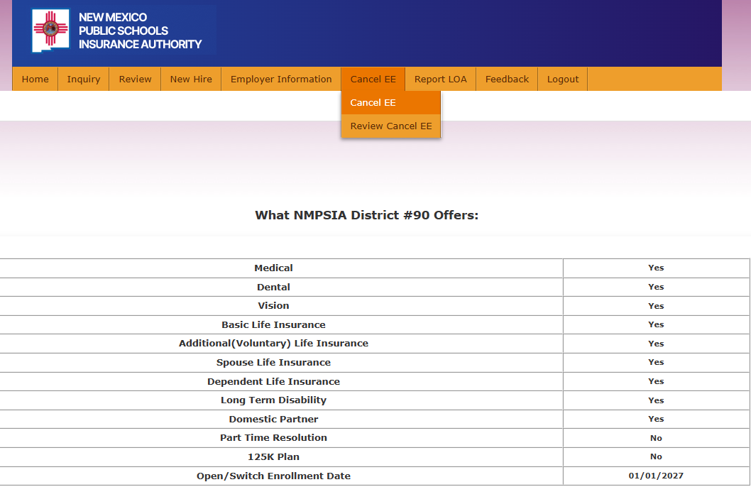
Step 1
6 of 12
From the Home page
Navigate to the Cancel EE tab
Helpful Tip
Be sure you are selecting the correct transaction before continuing. The Cancel EE option is used only to terminate an employee's NMPSIA coverage.

Slide 7
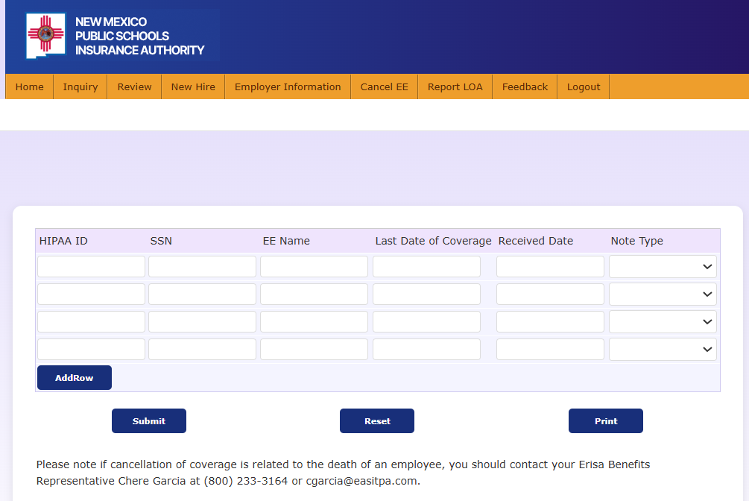
Step 2
7 of 12
Enter the employee's Social Security Number.
Verify the employee's name populates correctly.
Enter the Last Date of Coverage.
Enter the Received Date.
Important: The Last Date of Coverage must be the last day of the current month or a future date. Retroactive cancellations cannot be processed through the Employer Portal.
Helpful Tip
Before continuing, verify that the employee displayed on the screen is the correct individual. Using the wrong Social Security Number may result in processing delays.

Slide 8
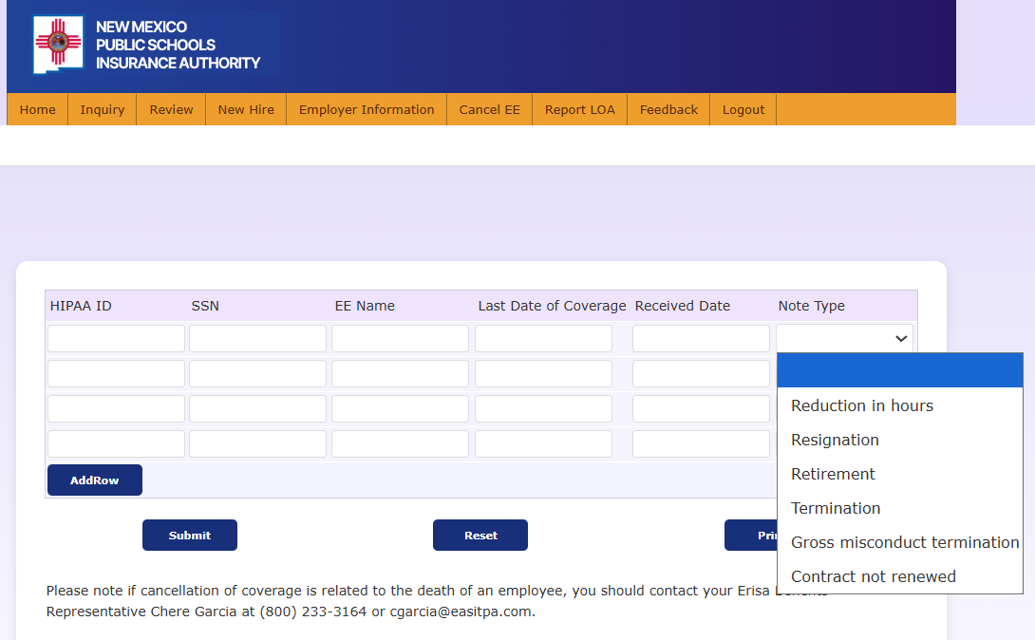
Step 3
8 of 12
Select the appropriate Reason for Cancellation.
Review all information for accuracy.
Select Submit.
Helpful Tip
Choose the cancellation reason that best matches the employee's employment status. Selecting the correct reason helps ensure accurate processing and reporting.

Slide 9
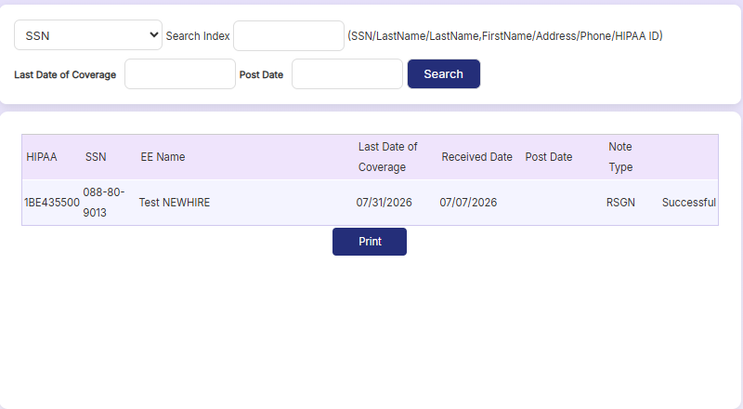
Step 4
9 of 12
CHECK: Once the transaction has been successfully submitted, a successful submission message will be displayed.

Slide 10
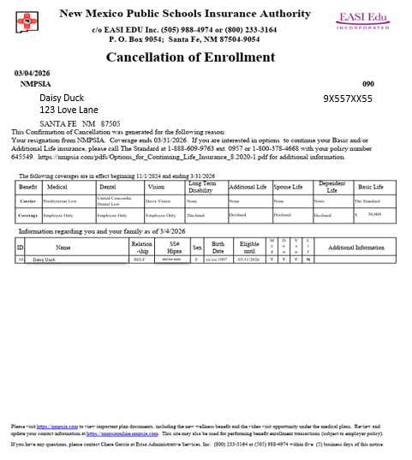
After Submission
10 of 12
The transaction will be routed to your EASI Edu Representative for final approval.
Cancellation of Enrollment is created and can be found on Employee account or Employer account under reports.
Helpful Tip
Verify all information is correct, distribute to employee or print for employee file if needed.

Slide 11
Common Errors
11 of 12
Employee not found – Verify the employee's Social Security Number (SSN), Name, or HIPAA ID and search again.
Invalid Effective Date – Verify the effective date is correct and meets NMPSIA eligibility requirements before submitting the transaction.
Missing Required Information – Make sure all required fields are complete
Incorrect Cancellation Reason – Select the cancellation reason that best matches the employee's employment status or reason for termination.
Helpful Tip
If an error continues, contact your EASI Edu Administrative Representative.

Slide 12
Need Assistance
12 of 12
Thank you for supporting your employees!
Contact Us:
EASI Edu
Phone: 1-800-233-3164
Contact your assigned representative for portal assistance.
Or
NMPSIA Benefits Team
Phone: 1-800-548-3724

